Slide 1
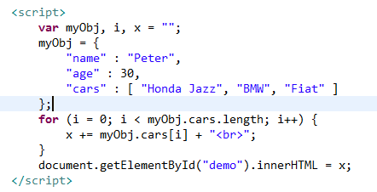
JSON Arrays – for loop
We can access array values by using a for loop

